Slide 1
Alberta High School Diploma
Planning Your Way Through The System

Slide 2
High School Graduation Basics
High School Diploma Minimum Requirements
🗹 Earn 105 Credits (min is 100)
🗹 English 30 (1 or 2)
🗹 Social 30 (1 or 2)
🗹 CALM
🗹 PE 10
🗹 Math 20 (1, 2 or 3)
🗹 Science 20 (Sci 20, Bio 20, Chem 20, Phy 20, Sci 24)
🗹 10 Credits from CTS, Fine Arts (art, drama, music), Second Language or LDC in these fields, PE 20 or 30, RAP or LDC in the F.
🗹 10 Other Grade 12 Credits, options may include Work Experience, RAP, Green Certificate, CTS Credits at the 30 level (example HCS 3000) any core course
You can track this on your MyPass account
Certificate of High School Achievement
Not as many requirements but often needs diligent planning with an administrator ,

Slide 3
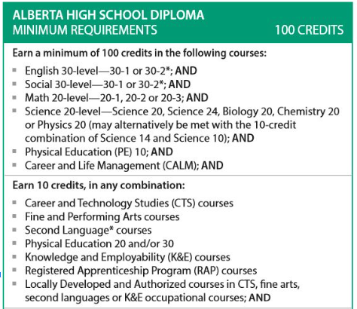
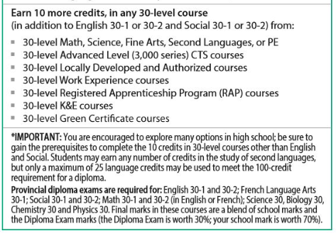
1
2
3

Slide 4
High School Graduation Basics Prerequisites and Sequences
Some courses have prerequisites or “take before” courses. For example before a student can register in Work Experience or RAP they have to take a course that teaches them about workplace safety. This course is called HCS 3000 and is worth one credit.
Other courses have sequences, for example you need to take grade 10 social (Social 10-1 or 2) before you can take grade 11 social (Social 20-1 or 2).
This is a good time to ask what RAP or WE and Green Certificate are.

Slide 5
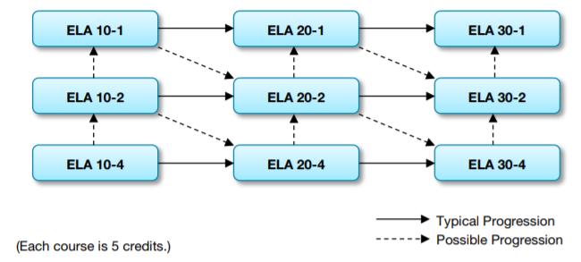
English Choice
Dash 1 is for student with strengths in reading comprehension and writing skills. It meets requirements for all post-secondary programs
Dash 2 is for students interested in popular culture & real world content. It is acceptable for many post-secondary programs at college

Slide 6
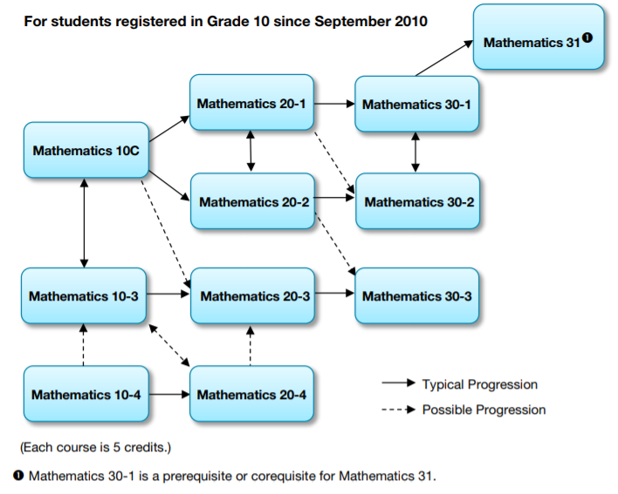
Mathematics

Slide 7
Mathematics
Dash 1 is for students who want to study math or sciences after high school
Math 31 may be required for post-secondary calculus courses
Dash 2 is for students who plan on attending post-secondary programs that do not need Calculus
Dash 3 is the math needed for most trades or entering the workforce
Dash 1 will meet all requirements for Trades, College and Universities

Slide 8
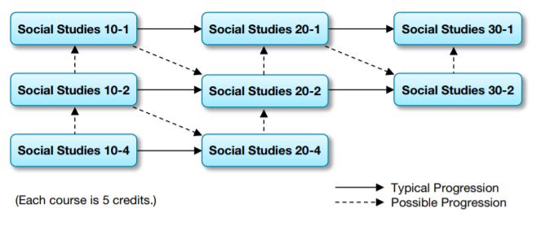
Social
Dash 1 is for the strong readers & meets requirements for many post-secondary programs
Dash 2 explores the same general concepts as -1, but the amount of work and reading is decreased. It can be used in some college or uni admission

Slide 9
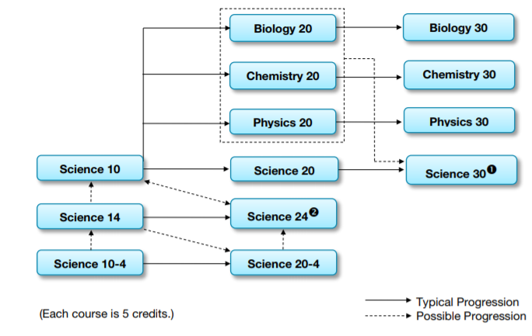
Science

Slide 10
Science
After Science 10, students will take Biology &/Or Chemistry &/Or Physics - a 20 level science is required. Universities usually look for a 30 level science.
Science 14 & 24 are general programs that meet the high school diploma requirements
* Science 14 and then 10 will also meet the science requirement

Slide 11
Off Campus Education
Off-campus education provides opportunities for students to apply their studies to the work environment
Allows students to discover their interests and aptitudes through real-life work activities
Worksite must be inspected by a teacher before students can begin logging hours
Courses
Work Experience 15,25,35 – focus on knowledge and skill development | 3 to 10 credits per course but only 15 credits may be used towards the high school diploma
Career Internship 10 – focus is on developing a profile of a work site and demonstrating employability skills | 3,4 or 5 credits
Registered Apprenticeship Program – similar to WE but within an apprenticeship trade | 5 to 40 credits and hours count towards first year apprenticeship hours
Green Certificate – Bee Keeper, Cow-Calf Beef, Dairy, Feedlot Beef, Field Crop, sheep or Swine Production, Equine Technician, to name a few | Training courses delivered on farm and tested by area testers. Earn up to 16 credits per specialization

Slide 12
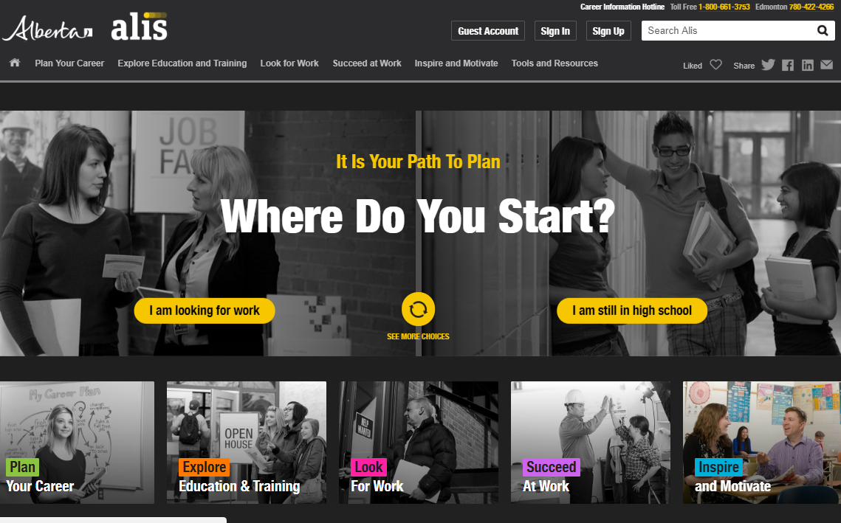
Meet ALIS
https://alis.alberta.ca/

Slide 13
Career Planning Five Common Career Transitions
1 Post Secondary
College
Bible College
University
Technical School
Wide Variety of Choice
2 Apprenticeship
Building Trades
Electrical Trades
Metal Trades
Service Trades
Vehicle Trades
Occupations
5 Direct Work Entry
Driving
Sales
Oil Extraction
Entrepreneurship
Customer Service
4 GAP Year
Travel
Service
2nd Language
May occur during P Secondary
3 Armed Forces
Officer Entrance – University
Combat
Trades Entrance or Polytechnic
Reserves
Cadets

Slide 14
Differences Between College and University
College
University
trains people in a field of work and develops workplace skills
disciplines within the school are often not connected so a student who switches from Geomatics to Criminal Justice will not likely receive transfer credit
students would normally be committed to a field of work before attending (General Studies and College Prep are exceptions)
often require a specific high school course(s) or two for admission
explores different ways of looking at real life - for example, students may learn to understand our world from a Sociological, Economic and Statistical point of view
after Point of View learning, students develop workplace skills
you can transfer between disciplines, majors and minors
admission usually requires Eng 30-1 and 3 or 4 other 30 level academic courses

Slide 15
A Student’s Research
 | Entrance Req | Duration | Tuition / Books / Fees | Notes
Lethbridge College - Agriculture Science Diploma | * Math 30-2 or higher * HS Diploma | 2 Years in Diploma and if you took Bio and Chem 30 you can move on to a degree | $6600 | Degree is offered at the college
Olds College Ag Management Diploma | Math 20-2 or 1 Eng 30-2 or 1 Bio or Chem 30 (or both at 20 level) | 2 Year Diploma with degree option for 2 more years | $8700 | Degree is offered at the college
Sask Polytech Agriculture and Food Production | Any Math at the grade 12 level | Varies but includes 3 paid work terms on farms | $5400 plus books | Listed as taking 80 weeks
Plumbing | Eng 20-2 Math 20-3 Science 10 or entrance exam | Apprenticeship | 8 weeks of school each year | Med Hat College has Pre employment plumbing program

Slide 16
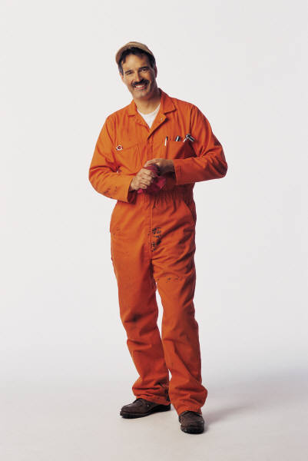
Real Life Career Planning
Science 10?
Albert took Science 14/24 in grade 10 because it was the quickest way to meet his diploma requirements.
In grade 12 he was offered a chance to apprentice with an Automotive Technician

Slide 17
A Thought on Obstacles
Albert was going to say no because he did not have Science 10, a required subject.
He was encouraged to say yes to the opportunity and then...
He took the apprenticeship entrance exam and found the math difficult.
His math teacher at school helped him and the second time around Albert aced the exam.
“Don’t Give Up! Obstacles can be overcome through strategy and learning”
Hidetaka Miyazaki

Slide 18
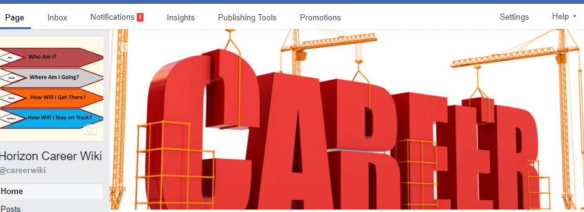
News and Opportunities
careerwiki.weebly.com
facebook.com/careerwiki

Slide 19
Resources Entrance Requirements for the Trades
Group A - Brown Grouping
Baker, Bricklayer, Cabinet Maker, Carpenter, Concrete Finisher, Cook, Crane, Floor Covering, Glazier, Hairstylist, Insulator, Ironworker, Lather, Locksmith, Painter, Parts, Sheet Metal, Steel and Plate Fitter, Tilesetter, Water Well and Welder
Must Have: English 10-2, Math 10-3 or pass the entrance exam
Recommended: English 30-2, Math 30-3, Phys or Chem or Science 20, CTS courses
Group B – Blue Grouping
Ag Equipment, Appliance, Automotive, Boilermaker, Communication, Electric Motor, Electrician, Elevator, Gasfitter, Heavy Equipment, Millwright, Motorcycle, Natural Gas, Plumber, Power System Electrician, Powerline, Sprinkler, Steamfitter, Transportation Refrigeration.
Must Have: English 20-2, Math 20-3, Science 10 or pass the entrance exam
Recommended: English 30-2, Math 30-3, Phys or Chem or Science 30, CTS courses
Group C Green Grouping
Autobody, Landscape, Machinist, Outdoor Power Equipment, Recreation Vehicle.
Must Have: English 10-2, Math 10-3, Science 10 or pass the entrance exam
Recommended: English 30-2, Math 30-3, Phys or Chem or Science 20, CTS courses
Trade Secrets

Slide 20
Making Plans and Choices
You may be thinking: “Planning all this is kind of complex”
BUT
Remember these things
You have a lot of help from:
Teachers who know a lot about each course and how well you did in the last course
Advisory teachers who are there to help you plan your high school years
Career Practitioners who know about the entrance requirements at colleges, universities, the trades, the army and more.
Principals who know a lot about courses, about the system and the rules
College and University advising staff who are very happy to meet with you

