Slide 1
Money and Managing It
Financial Management

Slide 2
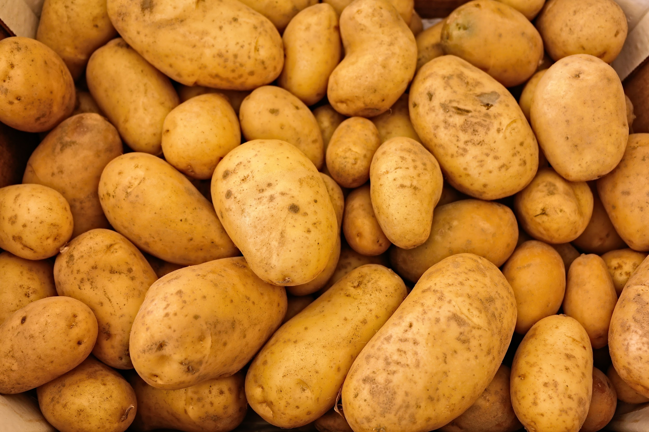
A Potato Theory of How Money Management Works
You have 400 potatoes
Spring has just sprung
You have some choices
People trade (not purchase)

Slide 3
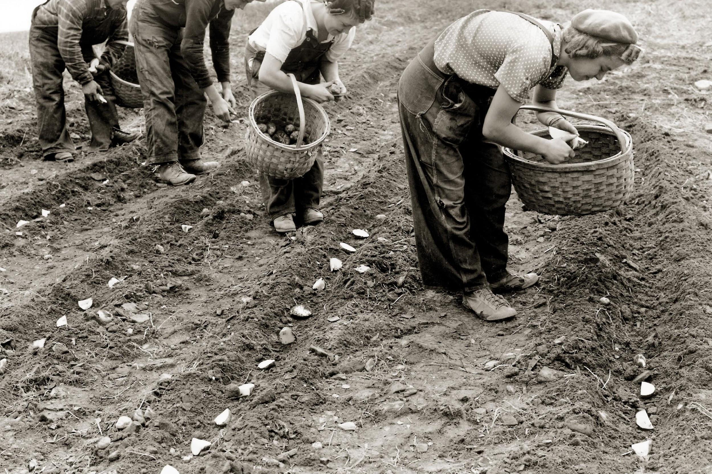
A Potato Theory of How Money Management Works
Scenario 1 - Invest Potatoes
You plant all your potatoes and you know this variety usually produces 10 potatoes per plant.
This will give you 4,000 potatoes to sell in the fall, which seems like a good profit.
However you have nothing to eat until harvest. Drought or pest could destroy your crop.

Slide 4
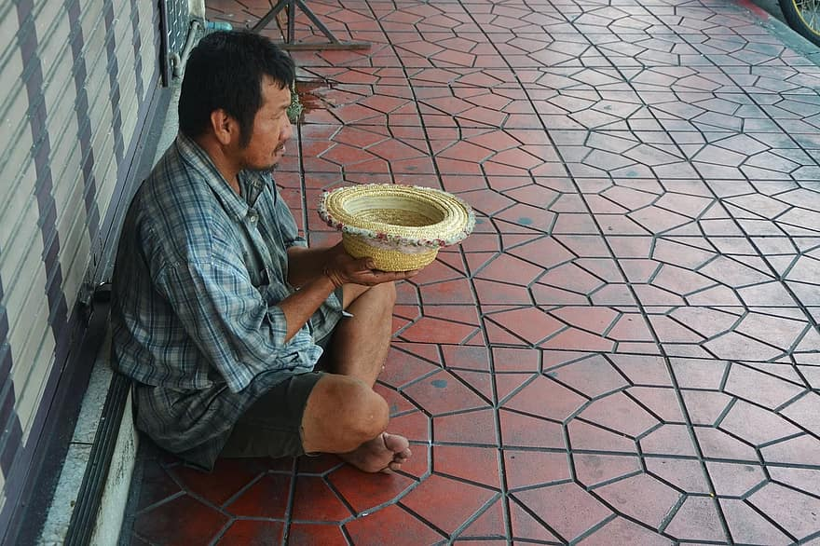
A Potato Theory of How Money Management Works
Scenario 2 - Spend the Potatoes
You decide to eat one potato per day (spending) and you have a few extra for special occasions. You save all the potatoes you have not yet eaten in a bin.
You are happy to have an entire years worth of food.
However in one year you will have no money and no food.
Potatoes can rot or freeze - storing them is a bit risky.

Slide 5
A Potato Theory of How Money Management Works
Scenario 3 - Spend and Invest
You decide to plant 200 potatoes and eat 200. You work in a kitchen to get the rest of your food during the winter months.
At harvest you could have 2000 potatoes, of which you save 400 for seed, 400 to eat and have 1200 to sell.
You assume the risks of crop failure
You assume the risks of storing your food
You do not owe any debt

Slide 6
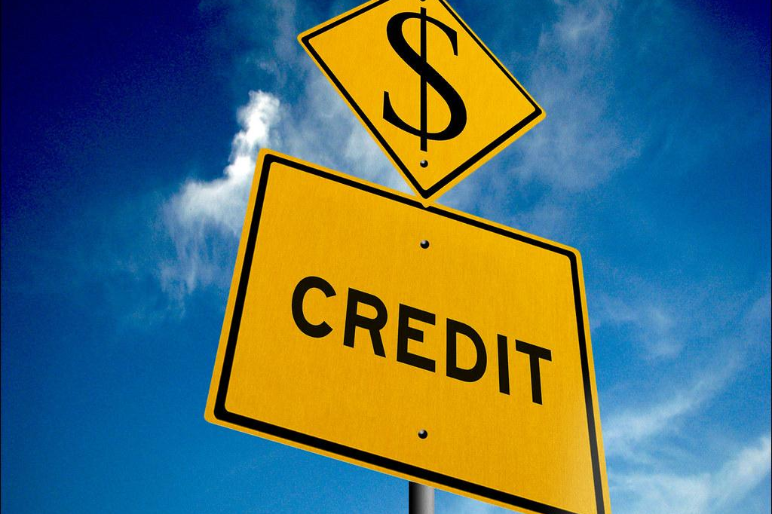
A Potato Theory of How Money Management Works
Scenario 4 - Invest and Borrow
You plant all your potatoes and borrow enough potatoes to eat until harvest but you have to return 20% simple interest.
You may harvest 4000 potatoes, putting 400 into seed, paying back the 400 you borrowed plus the 80 potatoes for interest and keeping 400 for food. You have 2720 potatoes to sell.
You assume the crop failure risks
If the harvest does not cover your input plus the amount you borrowed plus 20% - you could lose ownership of your land

Slide 7
Why Potatoes
In the example I used potatoes because they are less complex than money markets.
With money you have free market considerations, for example prices of things you sell can fluctuate, people stop buying your products, or input costs can go up. Additionally interest rates charged on money are compound and they can change.
So life is not as simple as a barter system that lets you trade potatoes, but the example does clarify some of your options.

Slide 8
Money or Financial Management is:
learning to manage these common options for your money:
Saving
Spending
Investing
Borrowing
You may also have these options with your money (or even your potatoes).
Loaning
Donating

